Slide 1



Gamiﬁcation and AI: Utilising Game-Based Learning to Enhance Educational Outcomes
Professor Gillian Vesty
Deputy Dean Learning and Teaching Accounting, Information System & Supply Chain (AISSC)
College of Business and Law (CoBL) RMIT University

Slide 2



Professor Gillian Vesty
Gillian is a member of CPA Australia, a Board Member of the Institute of Management Accountants, Australia and New Zealand.
Gillian’s research interests seek to align accounting with social impact research that address health and wellbeing challenges, taking a value-based healthcare perspective. Gillian is on the editorial board of Accounting Auditing and Accountability Journal and is an active Board Member of Games for Change, Asia Paciﬁc.
Gillian’s work demonstrates that serious games are a powerful vehicle for addressing wicked problems and provide an important nexus between teaching and research. Gillian has been involved in the design and development of a number of serious games recently recognised by 2024 PieOneer Awards.
Professor Gillian Vesty Deputy Dean Learning and Teaching
Accounting, Information System & Supply Chain (AISSC)
College of Business and Law (CoBL) RMIT University
Ready for what's next

Slide 3
Gamiﬁcation and AI: Utilising Game-Based Learning to Enhance Educational Outcomes
Learning Objectives:
Discover the principles of gamification in education
Analyse the impact of game-based learning on student engagement and performance
Design game-based learning activities that incorporate AI elements
Benefits for Teachers:
Learn how to create a more interactive and engaging learning environment
Enhance teaching methods to stimulate student participation
Develop skills to assess the eﬀectiveness of gamified learning experiences
Benefits for Students:
Experience learning in a fun and interactive way
Develop critical thinking and problem-solving skills through game-based scenarios
Increase motivation and enthusiasm for learning through gamification

Slide 4

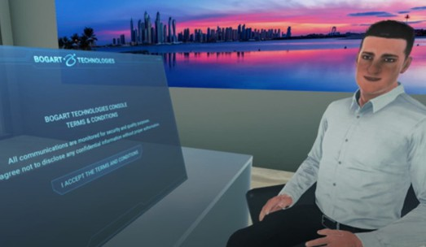
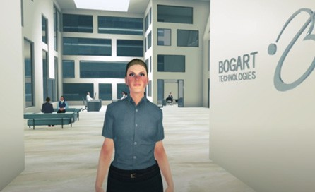
Bogart Technologies: Ethical Dilemmas
Accounting Ethics
Psychology
Law
Workplace Wellbeing
What is the relevance to your course?

Slide 5
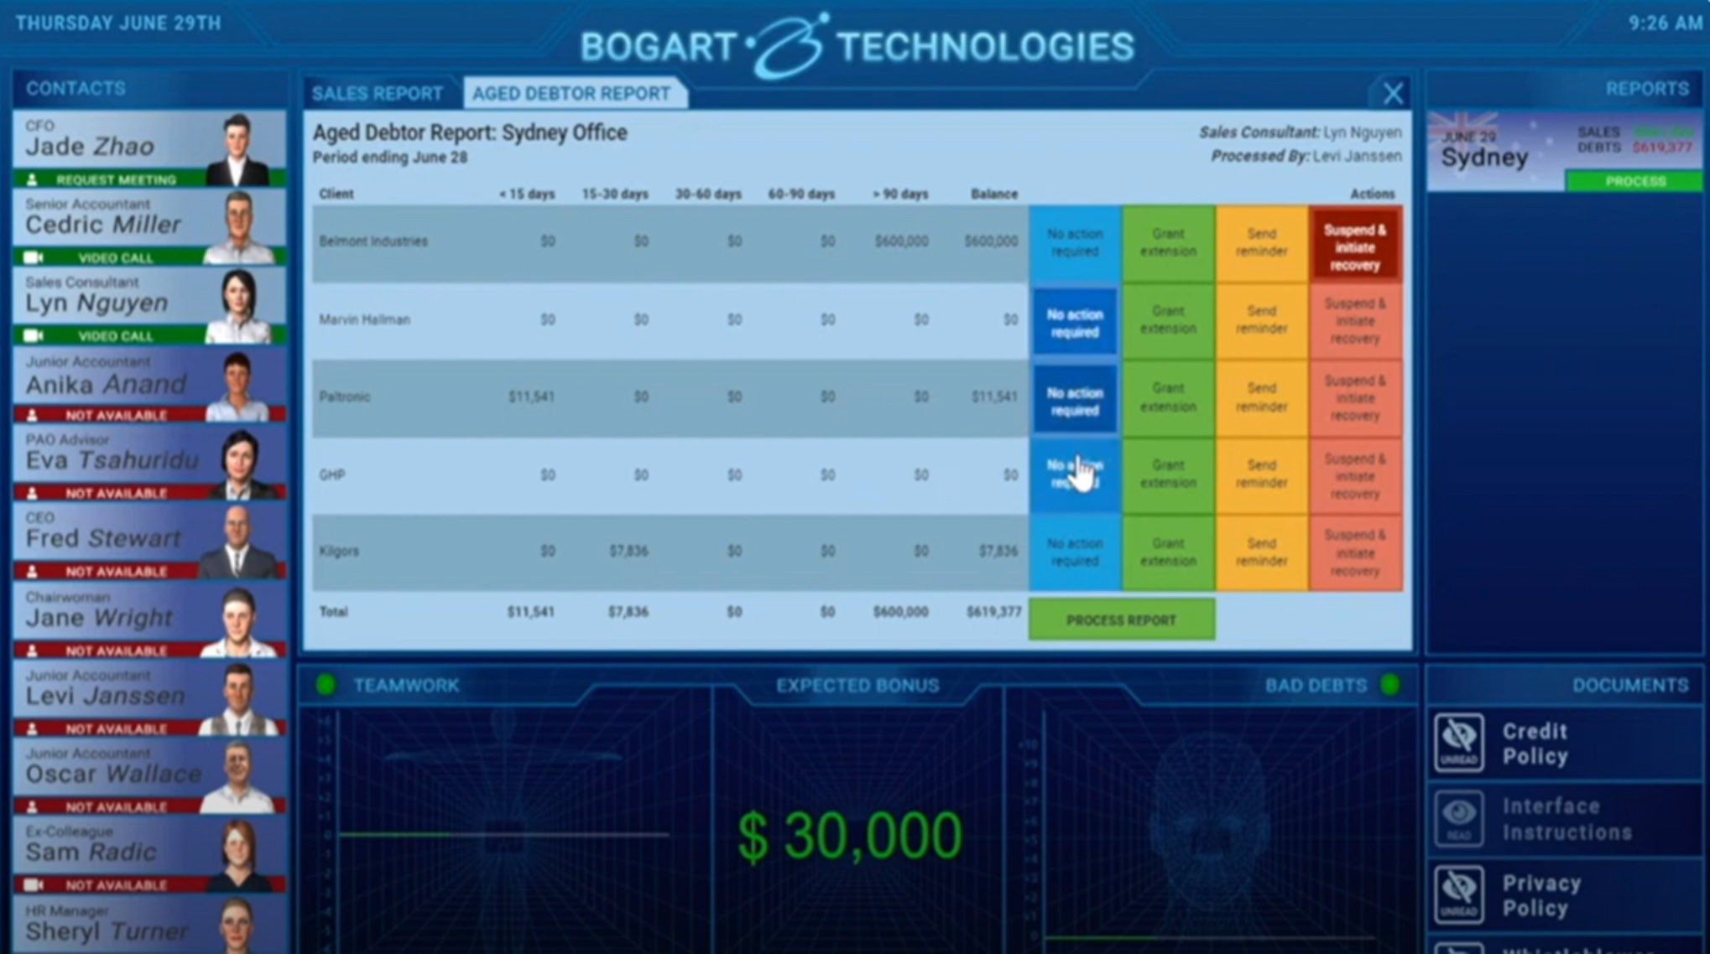

Slide 6
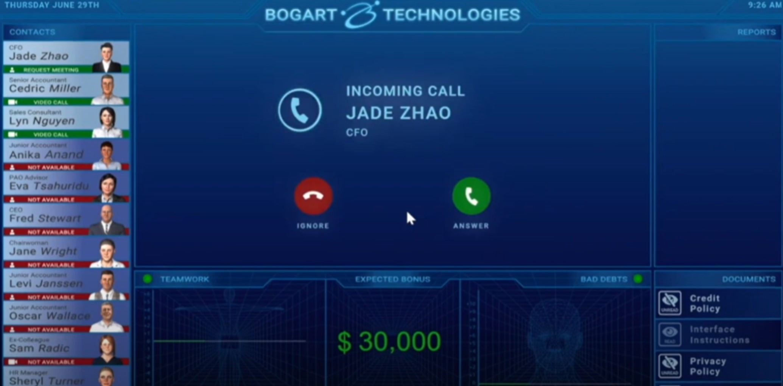

Slide 7
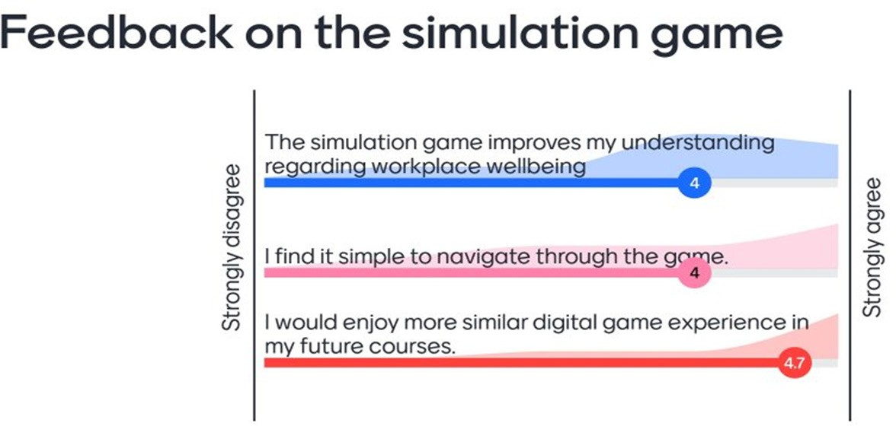
Using Bogart in Work Health Safety and Wellbeing

Slide 8
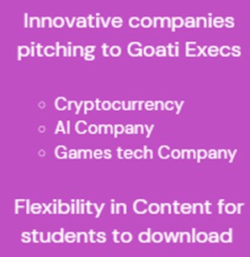
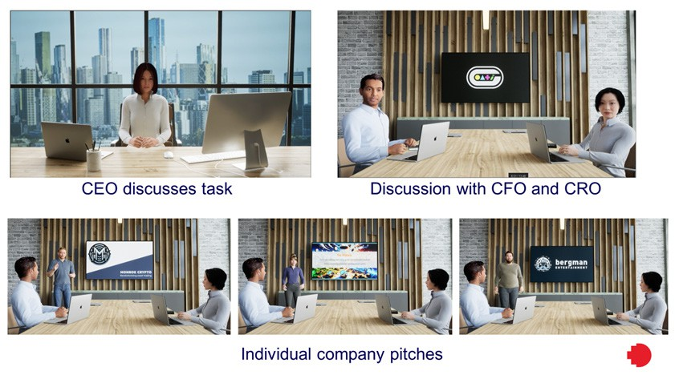
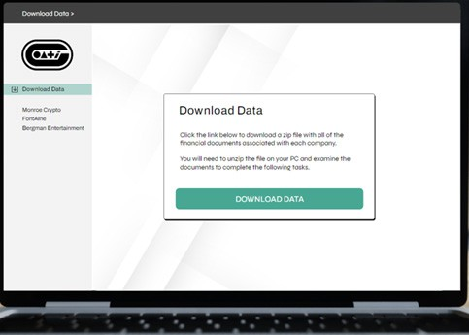

Prof Gillian Vesty Investigate Goati Accounting Game

Slide 9


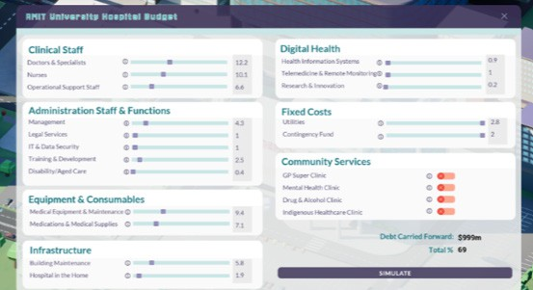
RMIT University Hospital Game

Slide 10
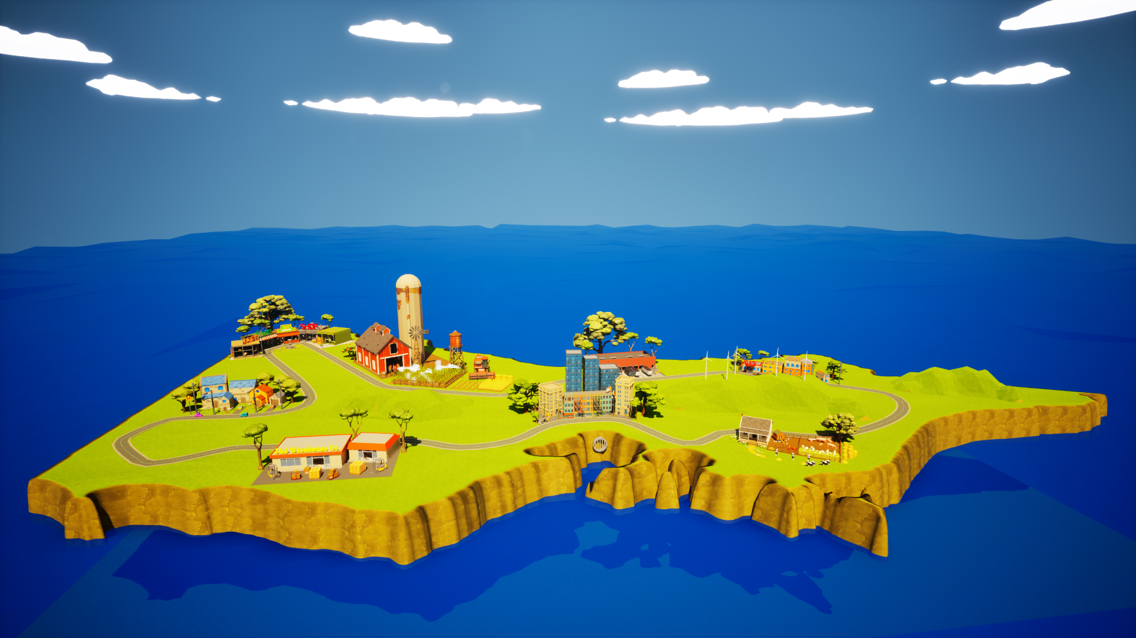

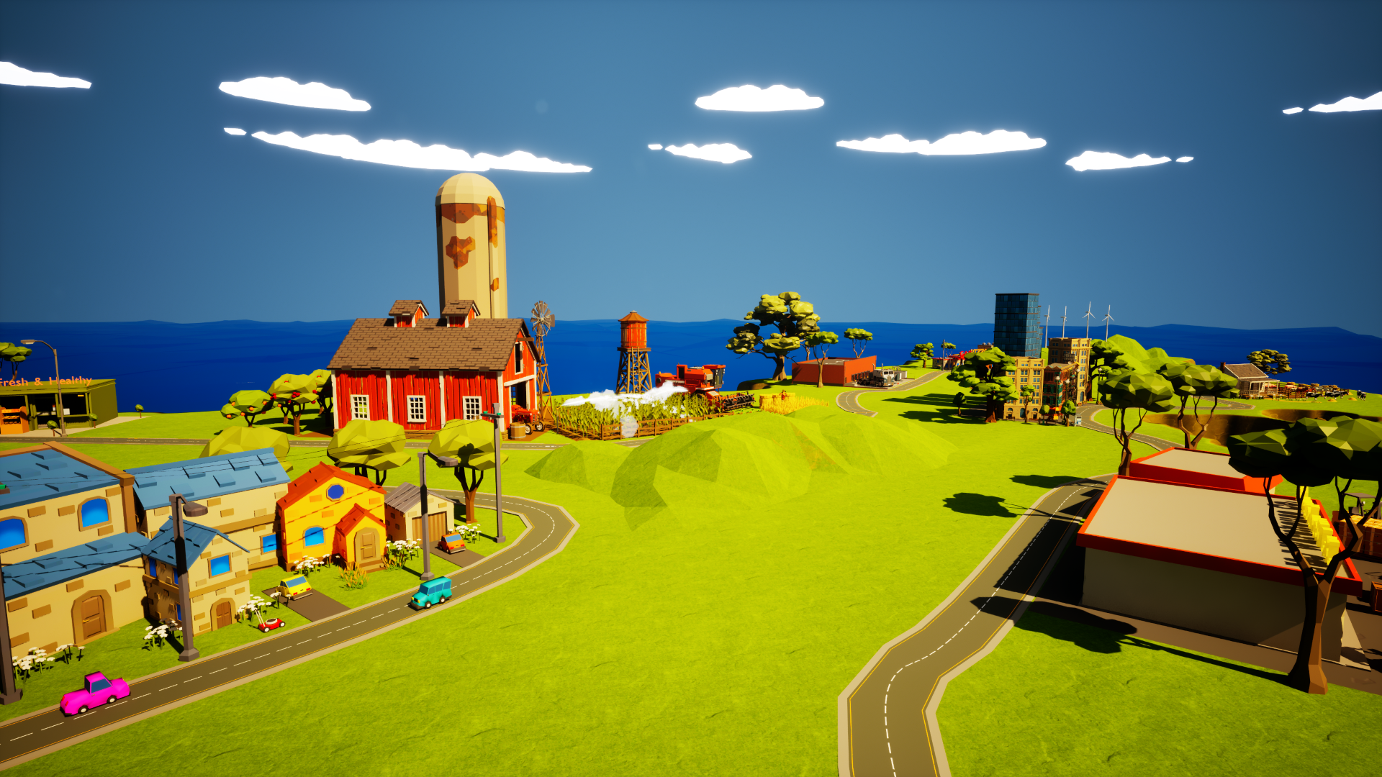
Foodbank Game
Used to develop business capabilities in:
Managing Problems - staffing; reputation; partners; finance
Logistics - Food insecurity
Community Impact; Natural Disasters

Slide 11
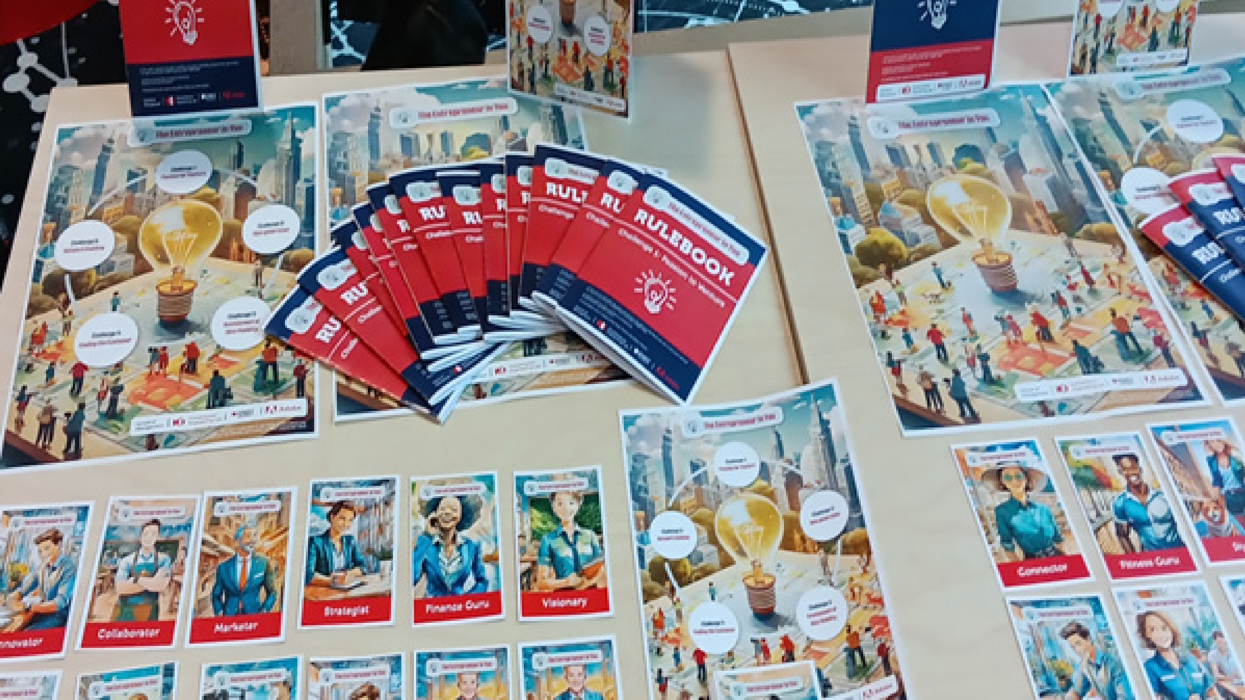
The Entrepreneur in You

Slide 12

The Chocolate Factory

Slide 13

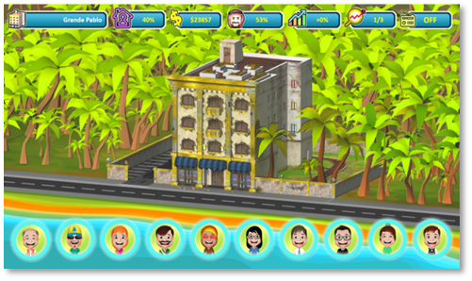
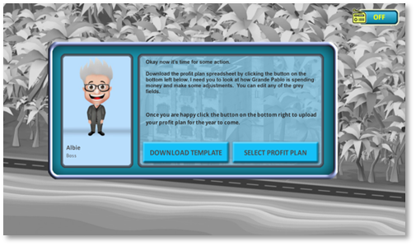
Lucro Island
Used to develop business capabilities in:
Budgeting and excel
Performance measurement
Sustainability
Collaboration and teamwork
Available @ Kilgors – Management Accounting Simulations

Slide 14





Q&A Session

Slide 15
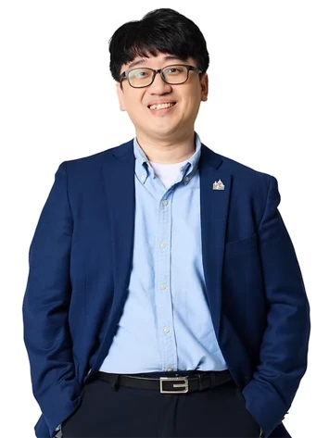
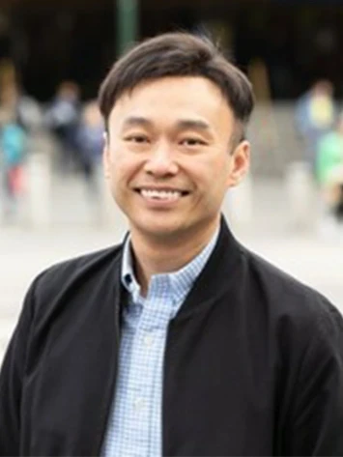
Meet Our Distinguished Speakers
Session 3 – 1 April 2025
Challenges and Opportunities in Integrating AI into Teaching and Learning
Prof. Junghyun KIM
Director
Air Transportation Systems Design
Laboratory (ATSDL)
Sejong University
Prof. Kok-Leong ONG
Director Technology Initiative
College of Business and Law (CoBL)
RMIT University

Slide 16
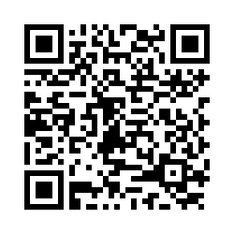
Your Feedback Shapes Future Sessions
Session 2

Slide 17



